Slide 1
N^2 is sum of the first N ***** numbers

Slide 2
The number N is a Square Number iff one can arrange N points in a *****

Slide 3
Square Number has an ***** number of factors
16
1
16
2
8
4

Slide 4
S
A
C
D
G
E
C
F
G
G

Slide 5
Start Node (Root)
S
A
C
D
G
E
Goal Node (Leaf)
C
F
Goal Node (Leaf)
G
G

Slide 6
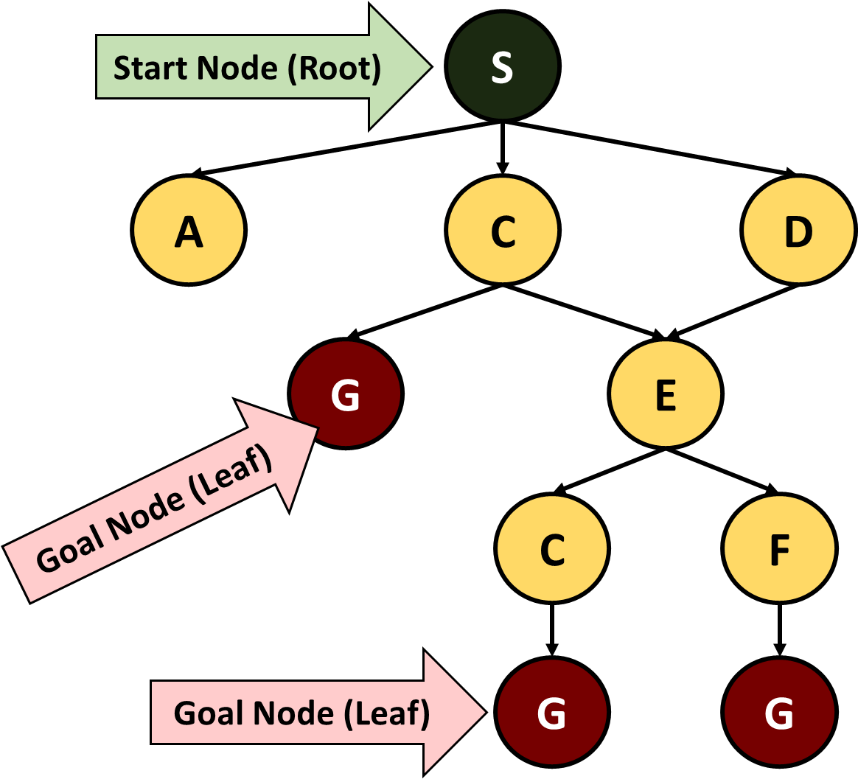
Tree Representation of Problem Space

Slide 7
Tree Representation of Problem Space

Slide 8
Number Line is a s***** line that serves as abstraction for real numbers
+2
-4
-3
-2
-1
0
1
2
3
4

Slide 9
Number Line is a straight line that serves as a*****n for real numbers
+2
-4
-3
-2
-1
0
1
2
3
4

Slide 10
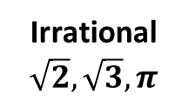
Number Type Ordering
Real
Rational 1/3, 1/5
Integer -1, -2, -3
Whole (zero)
Irrational
$$\sqrt{2},\sqrt{3}, π$$
Natural (Counting)
1, 2, 3

Slide 11
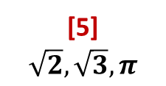
Number Type Ordering
[6]
[4] 1/3, 1/5
[3] -1, -2, -3
[2] (zero)
[5]
$$\sqrt{2},\sqrt{3}, π$$
[1] (Counting)
1, 2, 3

Slide 12
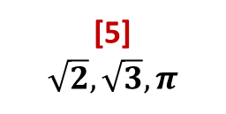
Number Type Classification
[6]
[4] 1/3, 1/5
[3] -1, -2, -3
[2] (zero)
[5]
$$\sqrt{2},\sqrt{3}, π$$
[1]
(Counting)
1, 2, 3

Slide 13
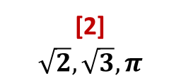
Number Type Classification (Reverse)
[1]
[3] 1/3, 1/5
[4] -1, -2, -3
[5] (zero)
[2]
$$\sqrt{2},\sqrt{3}, π$$
[6]
(Counting)
1, 2, 3

Slide 14
Number Line is a straight line that serves as a*****n for real numbers
Common_Multiples(a, b)
1
Multiples(b)
1
2
3
Multiples(a)
1
2
3
4
0
2
4
6
8
10
12
14
16
18
a
b

Slide 15
Common_Multiples(a,b)
Multiples(b)
b
2
3
4
Multiples(a)
a
2
3
4
5
6
0
2
4
6
8
10
12
14
16
18
20
22
24

Slide 16
Common_Multiples(a,b)
Multiples(b)
b
2
3
Multiples(a)
a
2
3
4
5
6
0
2
4
6
8
10
12
14
16
18
20
22
24

Slide 17
Common_Multiples(a,b)
Multiples(b)
b
2
3
Multiples(a)
a
2
3
4
5
6
0
2
4
6
8
10
12
14
16
18
20
22
24

Slide 18
Common_Multiples(a,b)
Multiples(b)
b
2
3
4
Multiples(a)
a
2
3
4
5
6
0
2
4
6
8
10
12
14
16
18
20
22
24

Slide 19
Common_Multiples(a,b)
Multiples(b)
b
2
3
4
Multiples(a)
a
2
3
4
5
6
0
2
4
6
8
10
12
14
16
18
20
22
24
Common_Multiples(a,b)
Multiples(b)
b
2
3
Multiples(a)
a
2
3
4
5
6
0
2
4
6
8
10
12
14
16
18
20
22
24

Slide 20
b
2
3
4
a
2
3
4
5
6
0
2
4
6
8
10
12
14
16
18
20
22
24

Slide 21
b
2
3
4
b
2
3
a
2
3
4
5
6
a
2
3
4
5
6
0
2
4
6
8
10
12
14
16
18
20
22
24
0
2
4
6
8
10
12
14
16
18
20
22
24

Slide 22
Common_Multiples(a,b)
b =
6
12
18
24
a =
4
8
12
16
20
24

Slide 23
Common_Multiples(a,b)
b =
8
16
24
a =
4
8
12
16
20
24

Slide 24
b =
6
12
18
24
a =
4
8
12
16
20
24

Slide 25
b =
8
16
24
a =
4
8
12
16
20
24

Slide 26
b =
8
16
24
a =
4
8
12
16
20
24
1
2
3
4
5
6
7
8
9
10
11
12

Slide 27
1
2
3
4
5
6
7
8
9
10
11
12

Slide 28
b =
6
12
18
24
a =
4
8
12
16
20
24
b =
4
8
24
a =
2
4
6
8
20
24

Slide 29
Common Multiples
A = B
A is Factor of B
All Multiples are Common
All Multiples(B) are Common
b
4
6
b
2
4
8
a
4
6
a
2
2
4
6
8
A and B are not Coprime
A and B are Coprime
Some Multiples(B) are common
Multiples(A*B) are Common
b
6
b
3
6
a
4
8
a
2
4
6
8

Slide 30
Common Multiples
A = B
A is Factor of B
??? Multiples are Common
All Multiples(B) are Common
b=
4
6
b=
2
4
8
a=
4
6
a=
2
2
4
6
8
A and B are not Coprime
A and B are Coprime
Some Multiples(B) are common
Multiples(A*B) are Common
b=
6
b=
3
6
a=
4
8
a=
2
4
6
8

Slide 31
Common Multiples
A = B
A is Factor of B
All Multiples are Common
All Multiples(???) are Common
b=
4
6
b=
2
4
8
a=
4
6
a=
2
2
4
6
8
A and B are not Coprime
A and B are Coprime
Some Multiples(B) are common
Multiples(A*B) are Common
b=
6
b=
3
6
a=
4
8
a=
2
4
6
8

Slide 32
Common Multiples
A = B
A is Factor of B
All Multiples are Common
All Multiples(B) are Common
b=
4
6
b=
2
4
8
a=
4
6
a=
2
2
4
6
8
A and B are not Coprime
A and B are Coprime
??? Multiples(B) are common
Multiples(A*B) are Common
b=
6
b=
3
6
a=
4
8
a=
2
4
6
8

Slide 33
Common Multiples
A = B
A is Factor of B
All Multiples are Common
All Multiples(B) are Common
b=
4
6
b=
2
4
8
a=
4
6
a=
2
2
4
6
8
A and B are not Coprime
A and B are Coprime
Some Multiples(B) are common
Multiples(???) are Common
b=
6
b=
3
6
a=
4
8
a=
2
4
6
8

Slide 34
Plus Operation on Digits
A
9
+
PREV
+
1
Input
B
9
Between 0 and 1
Between 0 and 1
Between 0 and 9
Between 0 and 9
C
(A + B + PREV)
19
(A + B + PREV)
whole
remainder
whole
remainder
Output
div(C, 10)
mod(C, 10)
1
9

Slide 35
Plus Operation on Digits
A
9
+
PREV
+
1
Input
B
9
Between 0 and ???
Between 0 and ???
Between 0 and 9
Between 0 and 9
C
(A + B + PREV)
19
(A + B + PREV)
whole
remainder
whole
remainder
Output
div(C, 10)
mod(C, 10)
1
9

Slide 36
Plus Operation on Digits
A
9
+
PREV
+
1
Input
B
9
Between 0 and 1
Between 0 and 1
Between 0 and 9
Between 0 and 9
C
(A + B ??? PREV)
19
(A + B ??? PREV)
whole
remainder
whole
remainder
Output
div(C, 10)
mod(C, 10)
1
9

Slide 37
Plus Operation on Digits
A
9
+
PREV
+
1
Input
B
9
Between 0 and 1
Between 0 and 1
Between 0 and 9
Between 0 and 9
C
(A + B + PREV)
19
(A + B + PREV)
whole
remainder
whole
remainder
Output
???(C, 10)
???(C, 10)
1
9

